Slide 1
Knowledge discovery with videos
At least that’s the hope.

Slide 2
Upload domain specific knowledge base
Ask and answer
Summarize the text -> query TwelveLabs
Get video snippet

Slide 3
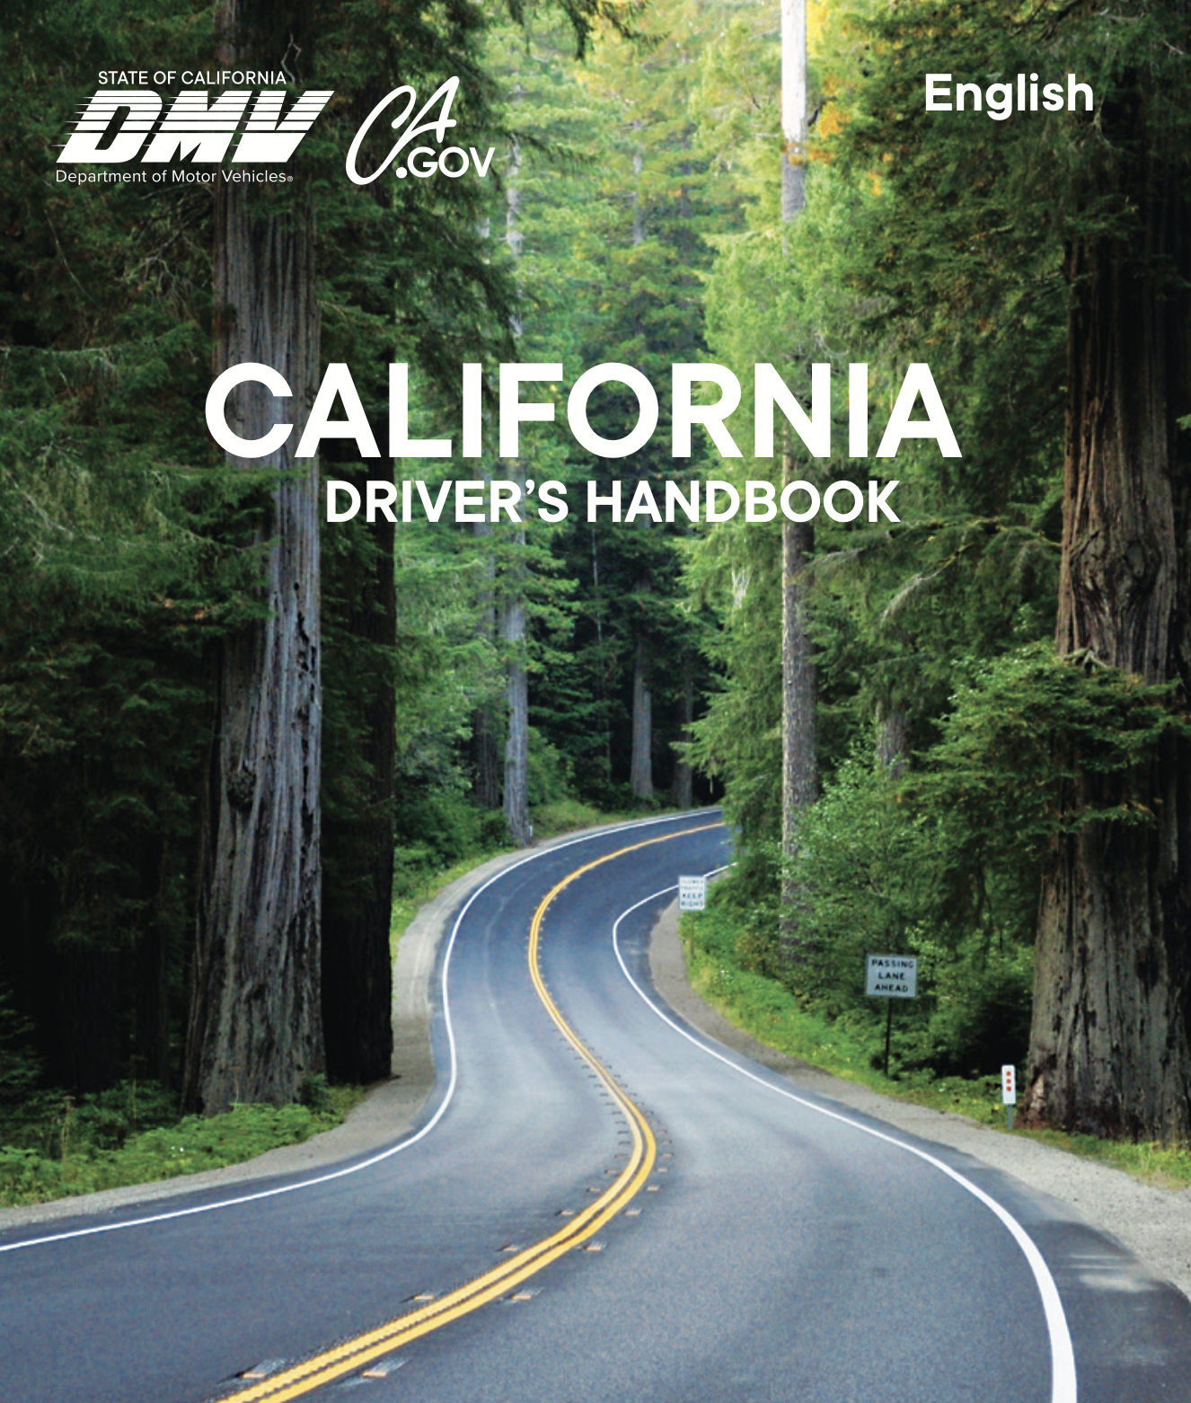

Slide 4
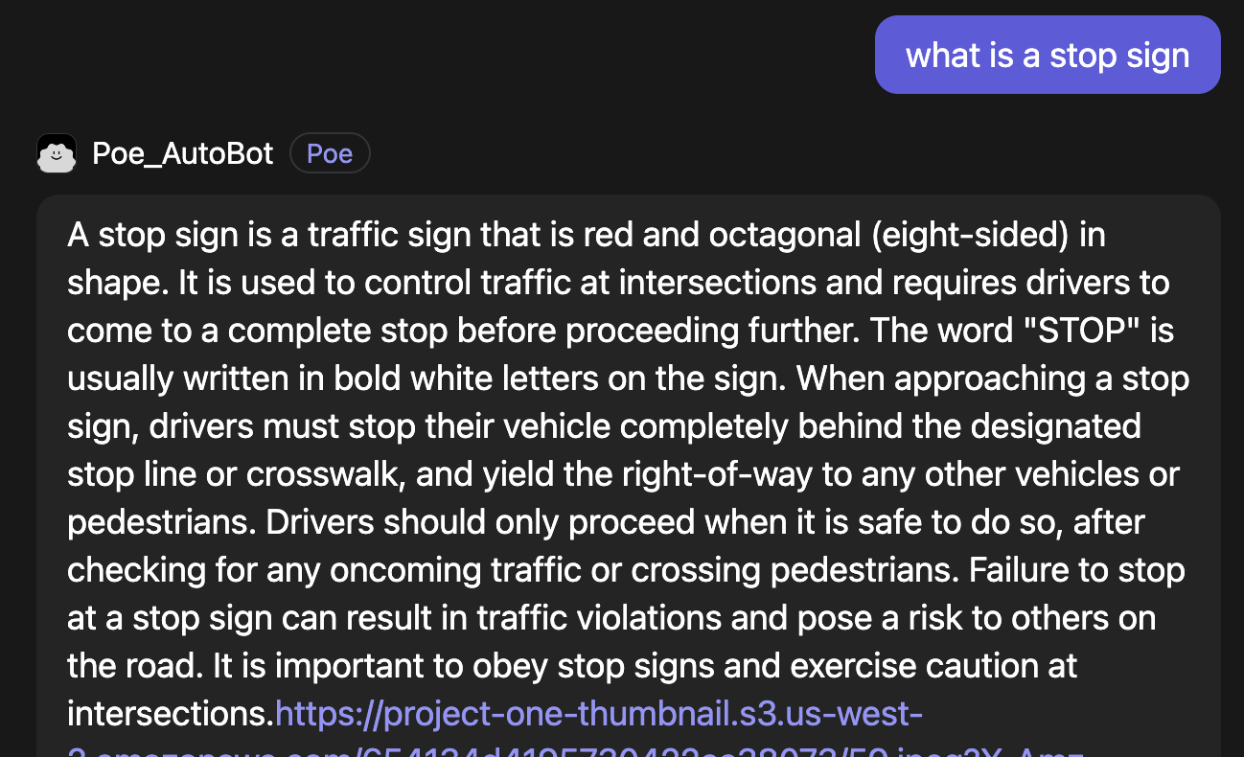

Slide 5
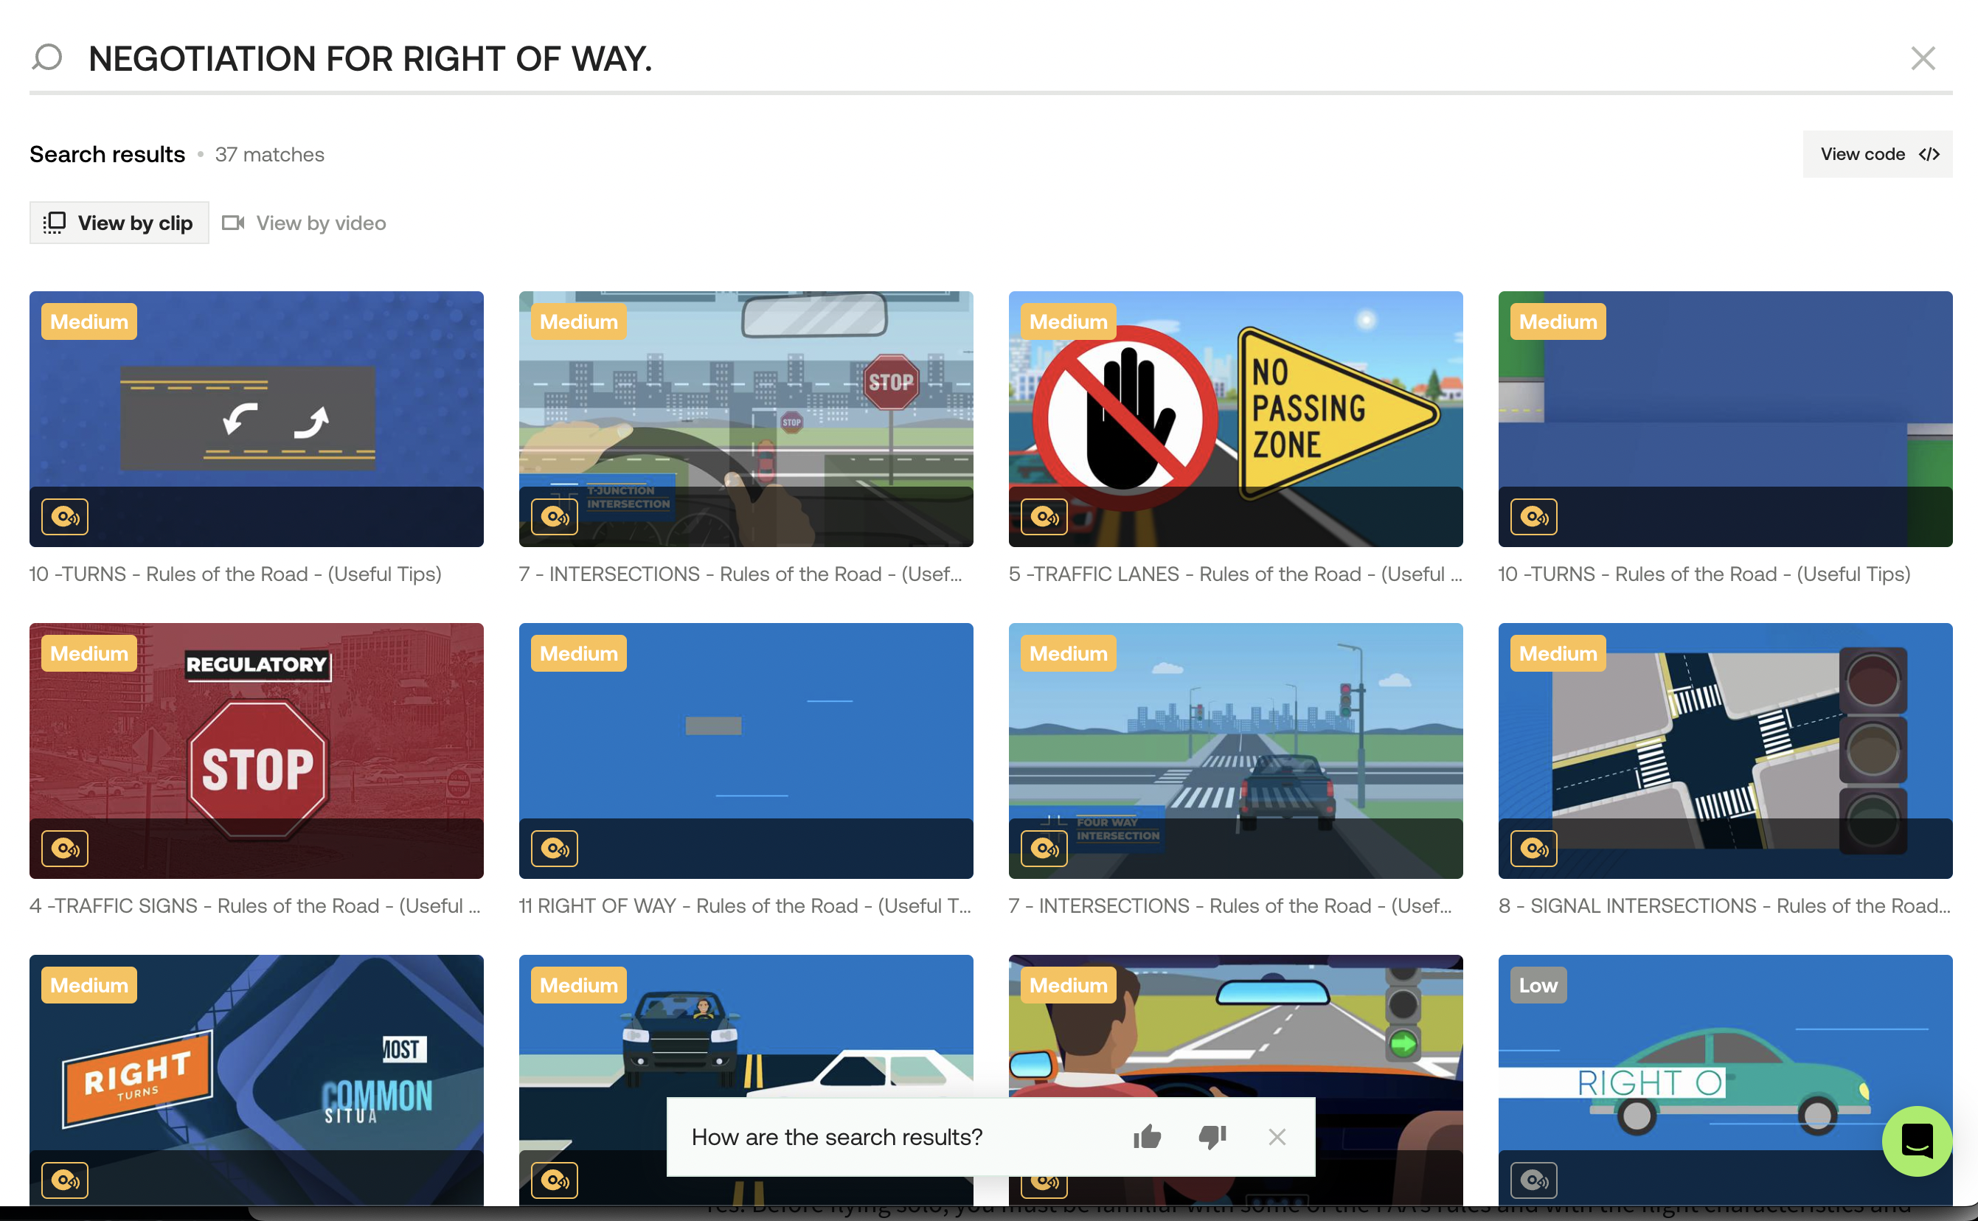

Slide 6
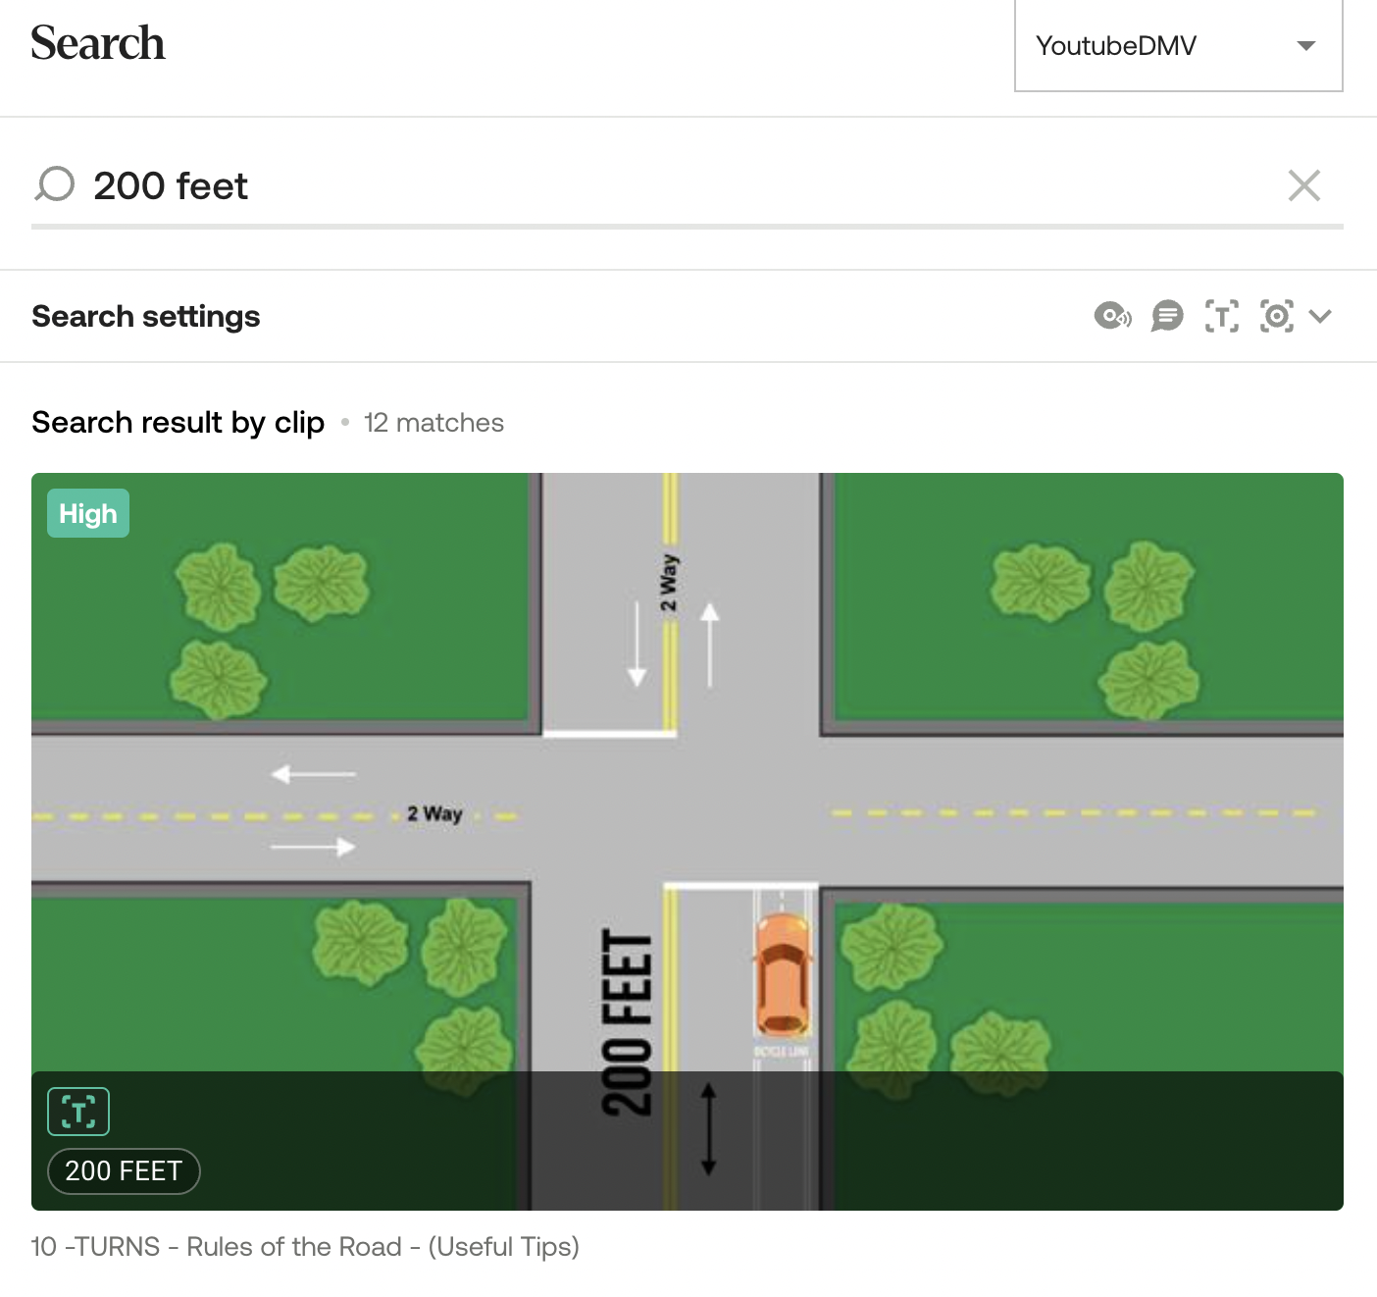

Slide 7
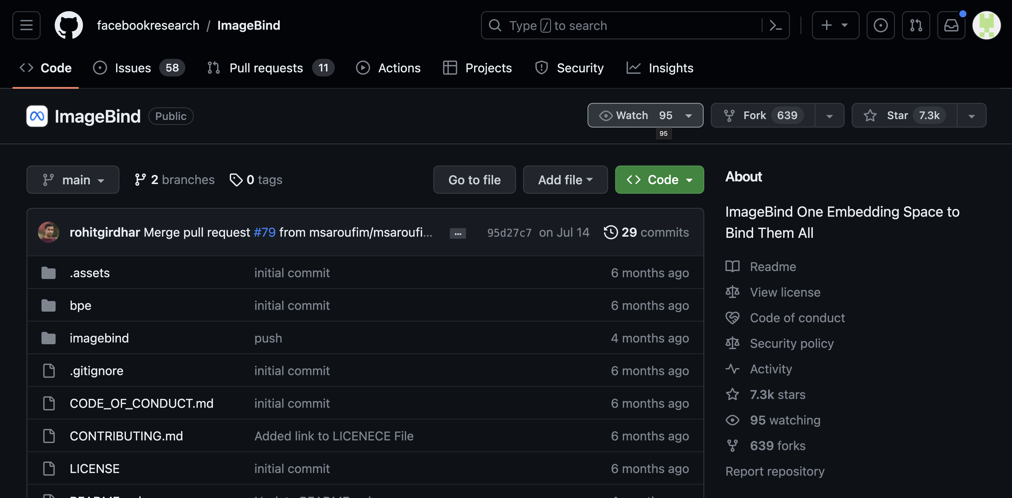
Issues encountered
PDF files not processed
Second call to Chat gpt didn’t go through
Twelvelabs doesn’t give you a video url, just a thumbnail
ImageBind doesn’t give good search results.

